Slide 1
Bruno Dupire
Bloomberg LP
Lecture 11
Volatility expansion

Slide 2
Volatility Expansion

Slide 3
Introduction
This talk aims at providing a better understanding of:
  How local volatilities contribute to the value of an option
  How P&L is impacted when volatility is misspecified
  Link between implied and local volatility
  Smile dynamics
  Vega/gamma hedging relationship

Slide 4
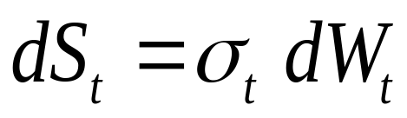


Framework & definitions
In the following, we specify the dynamics of the spot in absolute convention (as opposed to proportional in Black-Scholes) and assume no rates:
: local (instantaneous) volatility (possibly stochastic)
Implied volatility will be denoted by

Slide 5
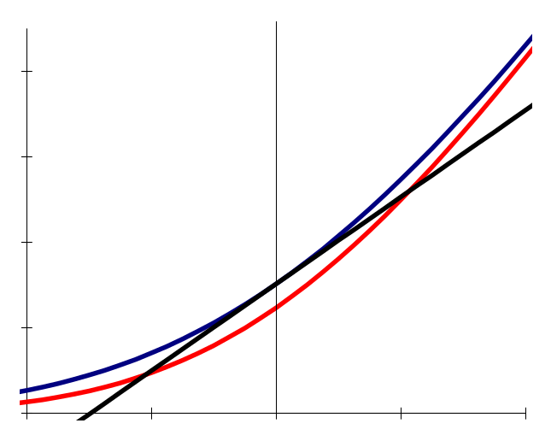
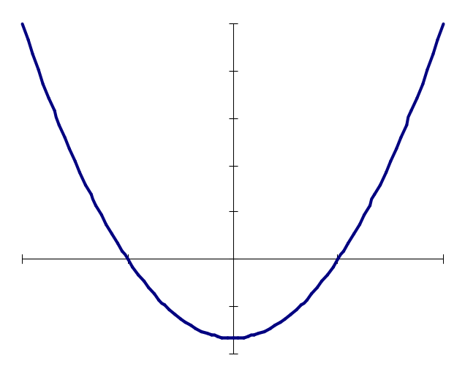
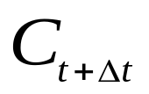








P&L of a delta hedged option
Option Value
P&L
Break-even
points
Delta hedge

Slide 6
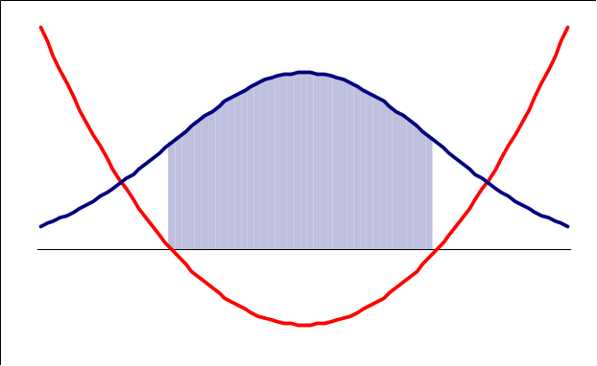
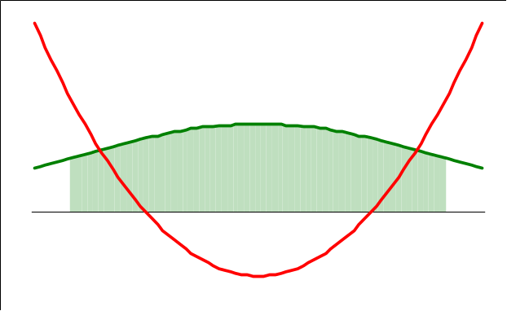
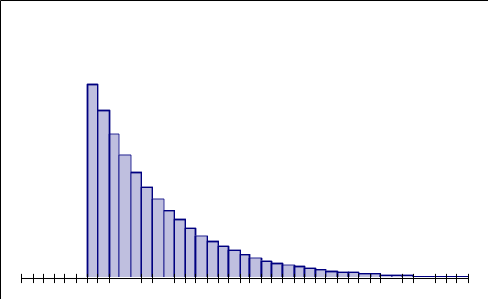
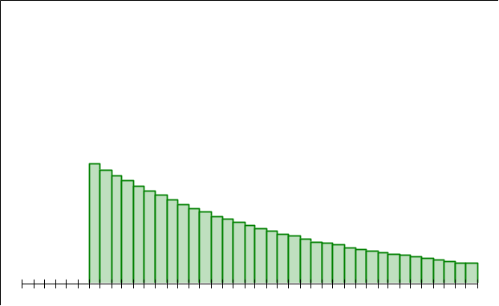

P&L of a delta hedged option (2)
Correct volatility
Volatility higher than expected
1std
1std
1std
1std
P&L Histogram
P&L Histogram
Expected P&L = 0
Expected P&L > 0
Ito: When , spot dependency disappears

Slide 7
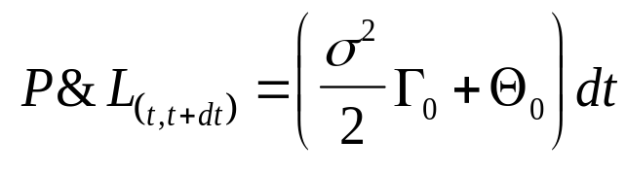
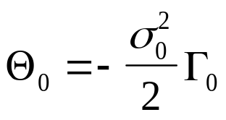
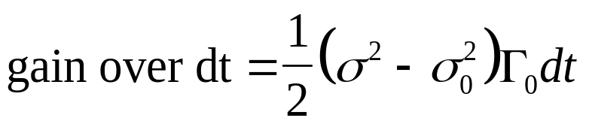
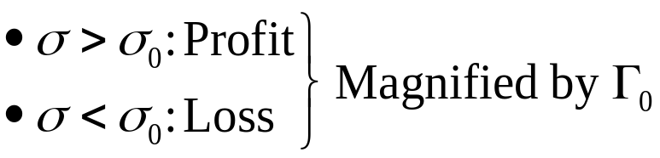
Black-Scholes PDE
P&L is a balance between gain from Γ and loss from Θ:
From Black-Scholes PDE:
=> discrepancy if σ different from expected:

Slide 8
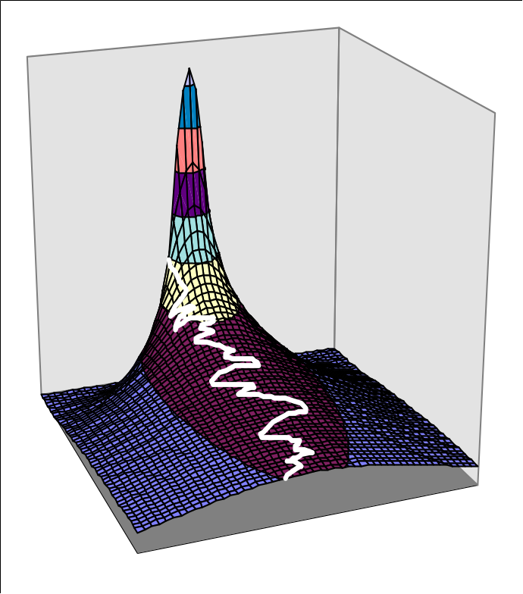
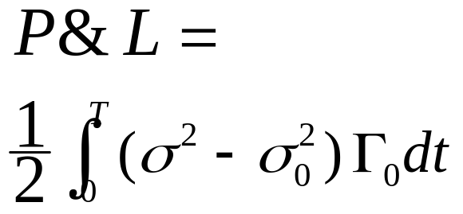
P&L over a path
Total P&L over a path
= Sum of P&L over all small time intervals
Gamma
No assumption is made on volatility so far
Time
Spot

Slide 9
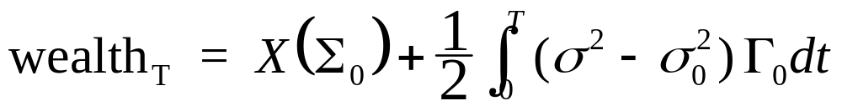

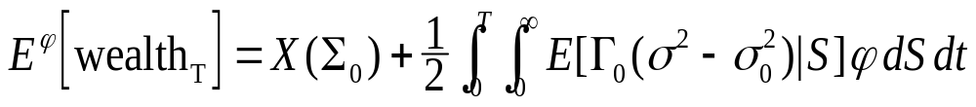
General case
Terminal wealth on each path is:
( is the initial price of the option)
Taking the expectation, we get:
The probability density φ may correspond to the density of a NON risk-neutral process (with some drift) with volatility σ.

Slide 10
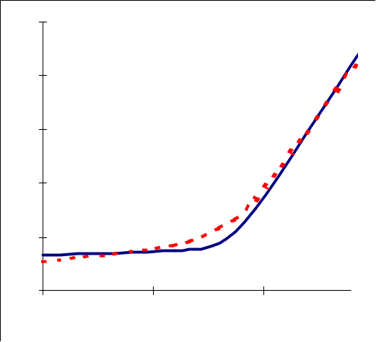
Non Risk-Neutral world
In a complete model (like Black-Scholes), the drift does not affect option prices but alternative hedging strategies lead to different expectations
Example: mean reverting process towards L with high volatility around L
We then want to choose K (close to L) T and σ₀ (small) to take advantage of it.
L
Profile of a call (L,T) for different vol assumptions
In summary: gamma is a volatility
collector and it can be shaped by:
  a choice of strike and maturity,
  a choice of σ₀ , our hedging volatility.

Slide 11


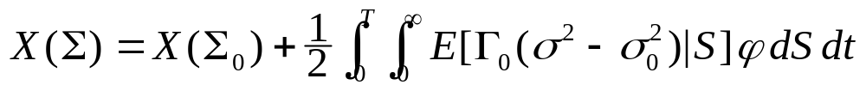
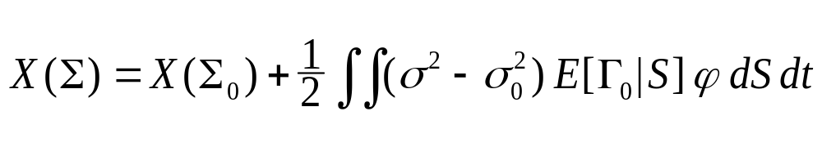
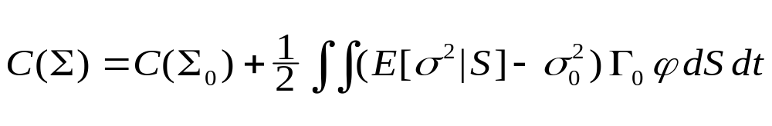
Average P&L
From now on, φ will designate the risk neutral density associated with .
In this case, E[wealth_{T}] is also and we have:
Path dependent option & deterministic vol:
European option & stochastic vol:

Slide 12
Quiz
Buy a European option at 20% implied vol
Realised historical vol is 25%
Have you made money ?
Not necessarily!
High vol with low gamma, low vol with high gamma

Slide 13
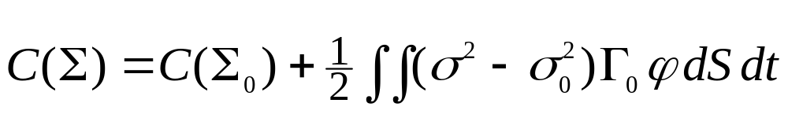
Expansion in volatility
An important case is a European option with deterministic vol:
The corrective term is a weighted average of the volatility differences
This double integral can be approximated numerically

Slide 14

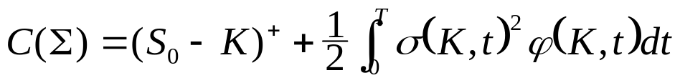
P&L: Stop Loss Start Gain
Extreme case:
This is known as Tanaka’s formula
S
Delta = 100%
K
Delta = 0%
t

Slide 15

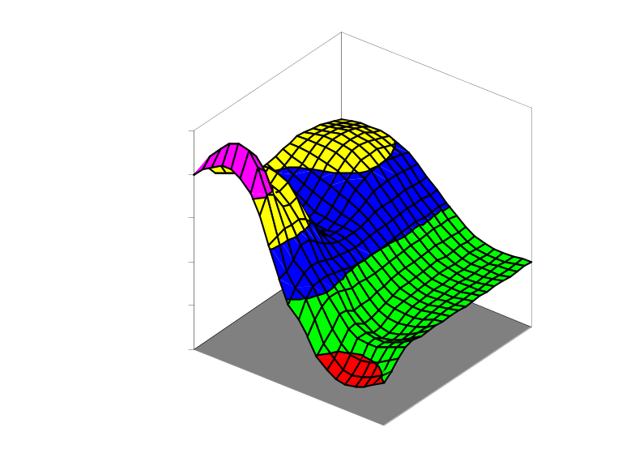
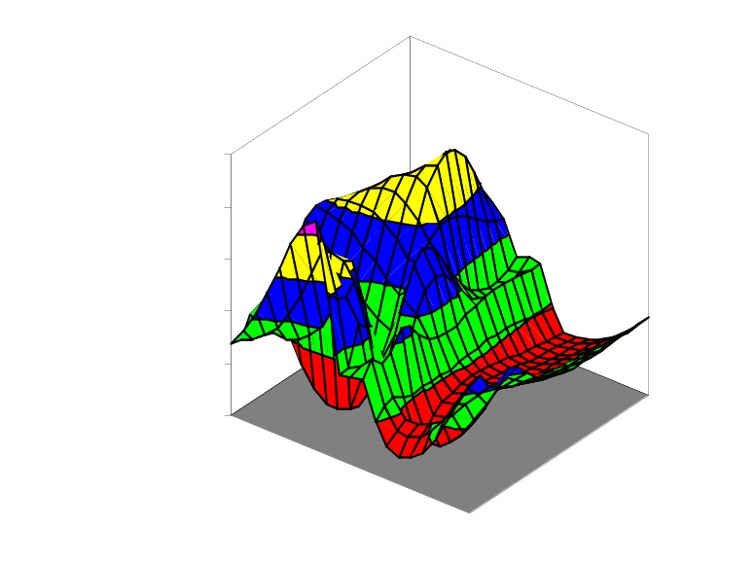

Local / Implied volatility relationship
Differentiation
Local volatility
Implied volatility
strike
maturity
spot
time
Aggregation

Slide 16
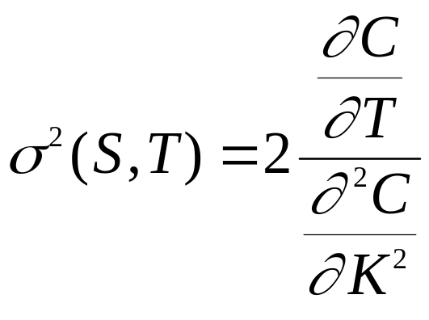
Smile stripping: from implied to local
Stripping local vols from implied vols is the inverse operation:
(Dupire 93)
Involves differentiations

Slide 17
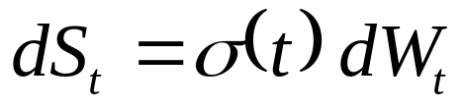
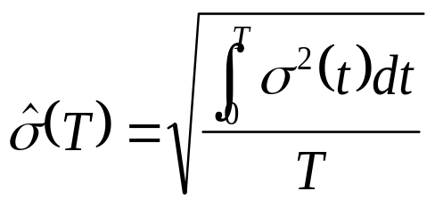
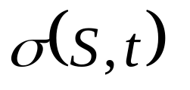
From local to implied: a simple case
Let us assume that local volatility is a deterministic function of time only:
In this model, we know how to combine local vols to compute implied vol:
Question: can we get a formula with ?

Slide 18

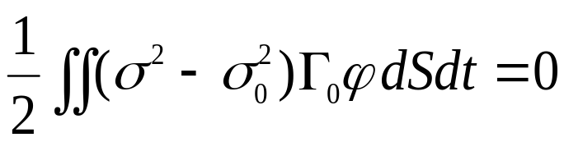
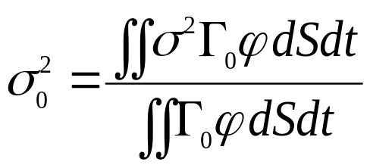
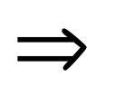


From local to implied volatility
When = implied vol
depends on
solve by iterations
Implied Vol is a weighted average of Local Vols
(as a swap rate is a weighted average of FRA)

Slide 19
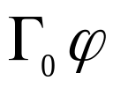
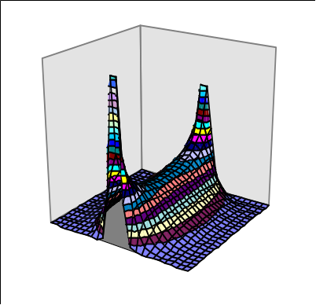
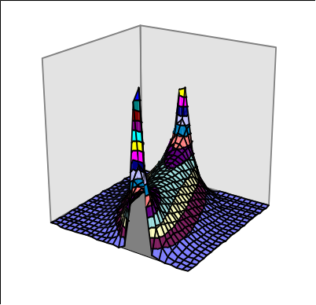
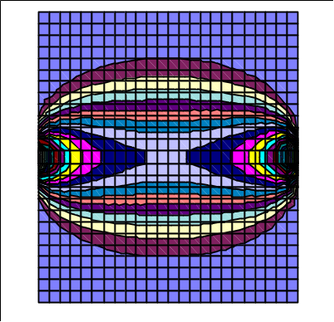
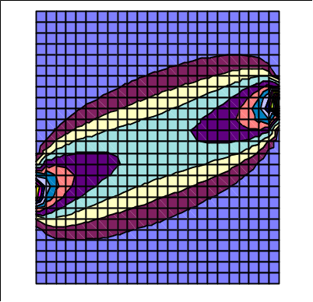
Weighting scheme
Weighting Scheme: proportional to
Out of the money case:
At the money case:
t
S
S₀=100
K=100
S₀=100
K=110

Slide 20
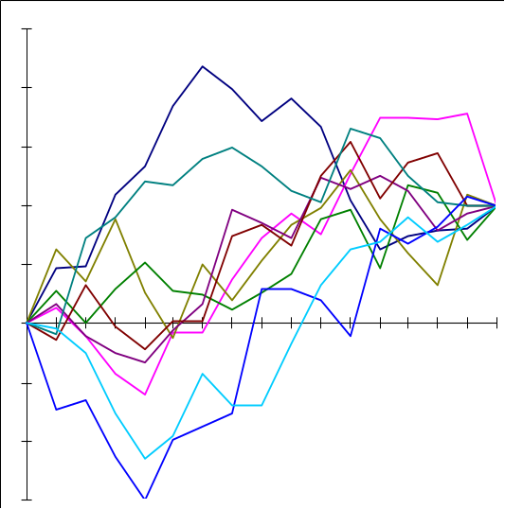
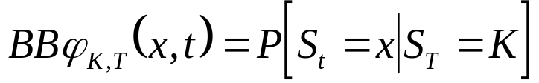
Weighting scheme (2)
Weighting scheme is roughly proportional to the brownian bridge density
Brownian bridge density:

Slide 21
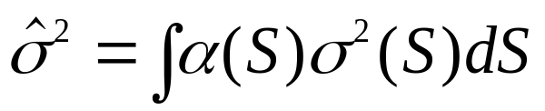
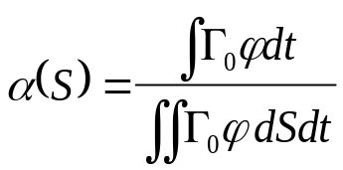
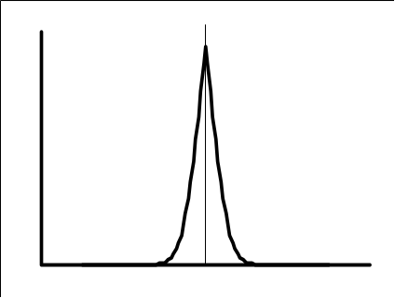
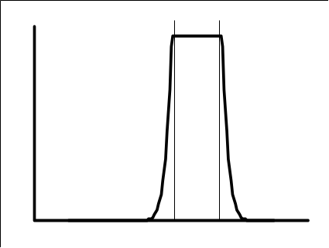

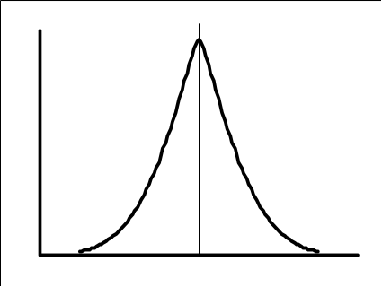
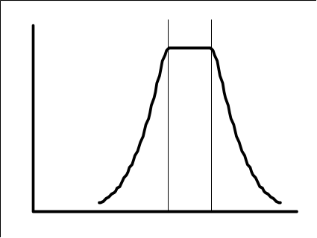
Time homogeneous case
ATM (K=S₀)
OTM (K>S₀)
α(S)
S₀
α(S)
S₀
K
small
S
S
α(S)
S₀
α(S)
S₀
K
large
S
S

Slide 22
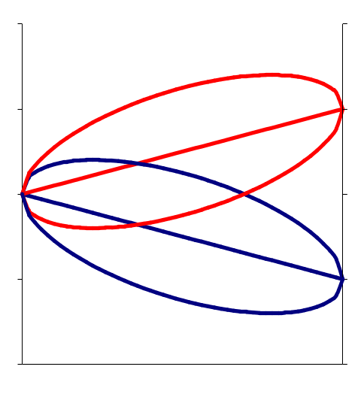
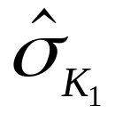
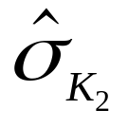
Link with smile
and are averages of the same local vols with different weighting schemes
K₂
S₀
K₁
t
=> New approach gives us a direct expression for the smile from the knowledge of local volatilities
But can we say something about its dynamics?

Slide 23
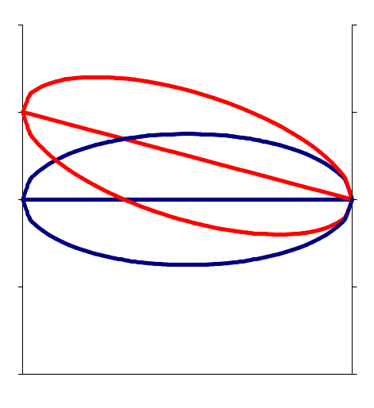
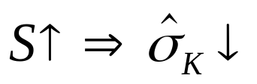
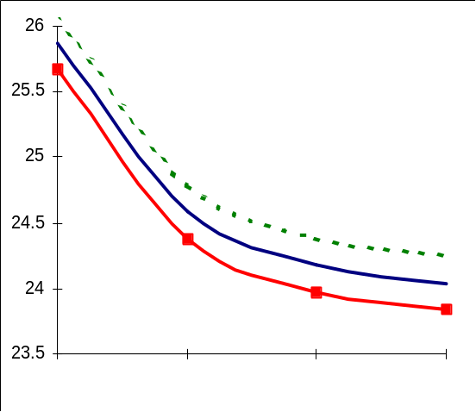
Smile dynamics
Weighting scheme imposes some dynamics of the smile for a move of the spot:
For a given strike K,
(we average lower volatilities)
S₁
S₀
K
t
Smile today (Spot S_{t})
&
Smile tomorrow (Spot S_{t+dt})
in sticky strike model
Smile tomorrow (Spot S_{t+dt})
if σ_{ATM}=constant
Smile tomorrow (Spot S_{t+dt})
in the smile model
S_{t+dt}
S_{t}

Slide 24






Sticky strike model
A sticky strike model ( ) is arbitrageable.
Let us consider two strikes K₁ < K₂
The model assumes constant vols σ₁ > σ₂ for example
1C(K₁)
Γ₁/Γ₂*C(K₂)
1C(K₂)
1C(K₁)
By combining K₁ and K₂ options, we build a position with no gamma and positive theta (sell 1 K₁ call, buy Γ₁/Γ₂ K₂ calls)

Slide 25








Vega analysis
If & are constant
Vega =

Slide 26
Gamma hedging vs Vega hedging
Hedge in Γ insensitive to realised historical vol
If Γ=0 everywhere, no sensitivity to historical vol => no need to Vega hedge
Problem: impossible to cancel Γ now for the future
Need to roll option hedge
How to lock this future cost?
Answer: by vega hedging

Slide 27


Superbuckets: local change in local vol
For any option, in the deterministic vol case:
For a small shift ε in local variance around (S,t), we have:
For a european option:

Slide 28

Superbuckets: local change in implied vol
Local change of implied volatility is obtained by combining local changes in local volatility according a certain weighting
sensitivity in local vol
weighting obtain using stripping formula
Thus:
cancel sensitivity to any move of implied vol
<=> cancel sensitivity to any move of local vol
<=> cancel all future gamma in expectation

Slide 29
Conclusion
This analysis shows that option prices are based on how they capture local volatility
It reveals the link between local vol and implied vol
It sheds some light on the equivalence between full Vega hedge (superbuckets) and average future gamma hedge

Slide 30





“Dual” Equation
The stripping formula
can be expressed in terms of
When
solved by

Slide 31






Large Deviation Interpretation
The important quantity is
If then satisfies:
and

Slide 32


Delta Hedging
We assume no interest rates, no dividends, and absolute (as opposed to proportional) definition of volatility
Extend f(x) to f(x,v) as the Bachelier (normal BS) price of f for start price x and variance v:
with f(x,0) = f(x)
Then,
We explore various delta hedging strategies

Slide 33




Calendar Time Delta Hedging
Delta hedging with constant vol: P&L depends on the path of the volatility and on the path of the spot price.
Calendar time delta hedge: replication cost of
In particular, for sigma = 0, replication cost of

Slide 34






Business Time Delta Hedging
Delta hedging according to the quadratic variation: P&L that depends only on quadratic variation and spot price
Hence, for
And the replicating cost of is
finances exactly the replication of f until

Slide 35

Daily P&L Variation

Slide 36

Tracking Error Comparison

Slide 37
Stochastic Volatility Models

Slide 38





Hull & White
Stochastic volatility model Hull&White (87)
Incomplete model, depends on risk premium
Does not fit market smile

Slide 39
Role of parameters
Correlation gives the short term skew
Mean reversion level determines the long term value of volatility
Mean reversion strength
  Determine the term structure of volatility
  Dampens the skew for longer maturities
Volvol gives convexity to implied vol
Functional dependency on S has a similar effect to correlation

Slide 40


Heston Model
Solved by Fourier transform:

Slide 41


Slide 42


Slide 43


Slide 44


Slide 45


Slide 46


Spot dependency
2 ways to generate skew in a stochastic vol model
Mostly equivalent: similar (St,σt ) patterns, similar future
evolutions
1) more flexible (and arbitrary!) than 2)
For short horizons: stoch vol model ⬄ local vol model + independent noise on vol.
σ
σ
S_{T}
S_{T}

Slide 47







Convexity Bias
K
likely to be high if

Slide 48



Impact on Models
Risk Neutral drift for instantaneous forward variance
Markov Model:
fits initial smile with local vols

Slide 49







Smile dynamics: Stoch Vol Model (1)
Skew case (r<0)
ATM short term implied still follows the local vols
Similar skews as local vol model for short horizons
Common mistake when computing the smile for another
spot: just change S₀ forgetting the conditioning on σ :
if S : S₀ → S⁺ where is the new σ ?
Local vols
σ
K

Slide 50



Smile dynamics: Stoch Vol Model (2)
Pure smile case (r=0)
ATM short term implied follows the local vols
Future skews quite flat, different from local vol model
Again, do not forget conditioning of vol by S
σ
Local vols
K

Slide 51
Forward Skew

Slide 52

Forward Skews
In the absence of jump :
model fits market
This constrains
a) the sensitivity of the ATM short term volatility wrt S;
b) the average level of the volatility conditioned to S_{T}=K.
a) tells that the sensitivity and the hedge ratio of vanillas depend on the calibration to the vanilla, not on local volatility/ stochastic volatility.
To change them, jumps are needed.
But b) does not say anything on the conditional forward skews.

Slide 53



Sensitivity of ATM volatility / S
At t, short term ATM implied volatility ~ σ_{t}.
As σ_{t} is random, the sensitivity is defined only in average:
In average, follows .
Optimal hedge of vanilla under calibrated stochastic volatility corresponds to perfect hedge ratio under LVM.

